Slide 1

Unit 02.03.04
CS 5220:
COMPUTER COMMUNICATIONS
Scheduling Approaches
XIAOBO ZHOU, Ph.D.
Professor, Department of Computer Science

Slide 2
Scheduling for MAC
Schedule frame transmissions to avoid collision in shared medium
  More efficient channel utilization
  Less variability in delays
  Can provide fairness to stations
  Increased computational or procedural complexity
Two main approaches
  Reservation
  Polling

Slide 3
Collision-free Reservation System
Reservation
interval
Frame
transmissions
r
d
d
d
r
d
d
d
Time
Cycle n
Cycle (n + 1)
r
=
1
2
3
M
Transmissions organized into cycles
Cycle: a reservation interval + frame transmissions

Slide 4
Reservation Scheme
The reservation interval has a mini-slot for each station to request reservations for frame transmissions
  The stations announce their intention to transmit a frame by broadcasting their reservation bit during the appropriate mini-slot
  By listening to the reservation interval, stations determine the order of frame transmissions in the corresponding cycle
  Mini-slot should cover the round-trip propagation delay
  Collision is avoided

Slide 5
Example (negligible propagation delay)
Initially stations 3 & 5 have reservations to transmit frames
8
(a)
r
3
5
r
3
5
r
3
5
8
r
3
5
8
r
3
t
Cycle 3: Station 8 becomes active and makes reservation
Cycle 3: now includes frame transmission from station 8

Slide 6
Example (non-negligible prop. delay)
Initially stations 3 & 5 have reservations to transmit frames
8
(b)
r
3
5
r
3
5
r
3
5
8
r
3
5
8
r
3
t
Cycle 2: Station 8 becomes active and makes reservation
Cycle 3: now includes frame transmission from station 8

Slide 7
Reservation System Options
Centralized or distributed system
  Centralized systems: A central controller listens to reservation information, decides order of transmission, issues grants
  Distributed systems: Each station determines its slot for transmission from the reservation information

Slide 8
Reservation System Options
Single or Multiple Frames
  Single frame reservation: Only one frame transmission can be reserved within a reservation cycle
  Multiple frame reservation: More than one frame transmission can be reserved within a minoslot
Channelized or Random Access Reservations
  Channelized (typically TDMA) reservation: Reservation messages from different stations are multiplexed without any risk of collision
  Random access reservation: Each station transmits its reservation message randomly until the message goes through

Slide 9
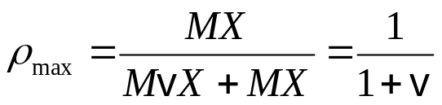
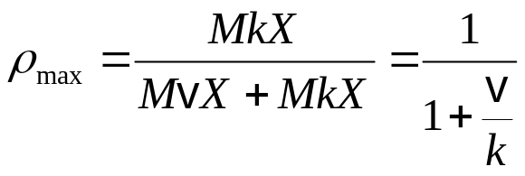
Efficiency of Reservation Systems
Assume mini-slot duration = vX (v < 1; negligible delay)
A single frame reservation scheme, M stations
  a single frame transmission requires (1+v)X seconds
  Link is fully loaded when all stations transmit, maximum efficiency is:
A k frame reservation scheme
  If k frame transmissions can be reserved with a reservation message and if there are M stations, as many as Mk frames can be transmitted in XM(k+v) seconds
  Maximum efficiency is:

Slide 10
Random Access Reservation Systems
Large number of light-traffic stations
  Dedicating a minislot to each station is inefficient
Slotted ALOHA reservation scheme
  Stations use slotted Aloha on reservation minislots
  On average, each reservation takes at least e minislot attempts
  Effective time required for the reservation is 2.71vX
X X(1+ev)
1 1 + 2.71v
ρ_{max} = =

Slide 11
Example: GPRS
General Packet Radio Service
  Packet data service in GSM cellular radio
  GPRS devices, e.g. cellphones or laptops, send packet data over radio and then to Internet
  Slotted Aloha MAC used for reservations
  Single & multi-slot reservations supported

Slide 12

Polling Systems
Centralized systems: A central controller accepts requests from stations and issues grants to transmit
Distributed systems: Stations implement a decentralized algorithm to determine transmission order
Central
Controller

Slide 13
Polling System Options
Service Limits: How much is a station allowed to transmit per poll?
  Exhaustive: until station’s data buffer is empty (including new frame arrivals)
  Gated: all data in buffer when poll arrives
  Frame-Limited: one frame per poll
  Time-Limited: up to some maximum time
Priority mechanisms
  More bandwidth and lower delay for stations that appear multiple times in the polling list
  Issue polls for stations with message of priority k or higher

Slide 14
Comparison of MAC approaches
Channelization
  Feasible if traffic is steady
Aloha & Slotted Aloha
  Simple & quick transfer at very low load
  Accommodates large number of low-traffic bursty users
  Highly variable delay at moderate loads
  Efficiency does not depend on a
CSMA & CSMA-CD
  Quick transfer and high efficiency for low delay-bandwidth product
  Can accommodate large number of bursty users
  Variable and unpredictable delay

Slide 15
Comparison of MAC approaches (Cont)
Reservation
  On-demand transmission of bursty or steady streams
  Accommodates large number of low-traffic users with slotted Aloha reservations
  Can incorporate QoS
  Handles large delay-bandwidth product via delayed grants
Polling
  Generalization of time-division multiplexing
  Provides fairness through regular access opportunities
  Can provide bounds on access delay
  Performance deteriorates with large delay-bandwidth product

Slide 16
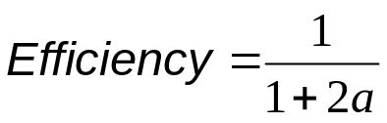
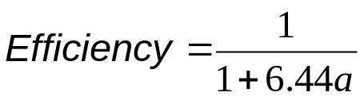
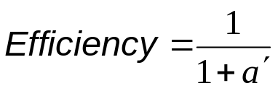
Typical MAC Efficiencies
Two-Station Example:
If a<<1, then efficiency close to 100%
As a approaches 1, the efficiency becomes low
CSMA-CD protocol:
Token-ring network
a΄= latency of the ring (bits)/average frame length

Slide 17
Typical Delay-Bandwidth Products
Distance | 10 Mbps | 100 Mbps | 1 Gbps | Network Type
1 m | 3.33 x 10⁻⁰² | 3.33 x 10⁻⁰¹ | 3.33 x 10⁰ | Desk area network
100 m | 3.33 x 10⁰¹ | 3.33 x 10⁰² | 3.33 x 10⁰³ | Local area network
10 km | 3.33 x 10⁰² | 3.33 x 10⁰³ | 3.33 x 10⁰⁴ | Metropolitan area network
1000 km | 3.33 x 10⁰⁴ | 3.33 x 10⁰⁵ | 3.33 x 10⁰⁶ | Wide area network
100000 km | 3.33 x 10⁰⁶ | 3.33 x 10⁰⁷ | 3.33 x 10⁰⁸ | Global area network
Long and/or fat pipes give large products and a (normalized delay)

Slide 18
Summary: MAC protocol features
Delay-bandwidth product / normalized delay
Efficiency
Transfer delay
Fairness
Reliability
Capability to carry different types of traffic
Quality of service
Cost

